Slide 1
BREW-TEA-FULL
P R E S E N T A T I O N

Slide 2





INTRODUCTION
A DIVERSE TEAM OF TALENTED NINJA TURTLES

Slide 3
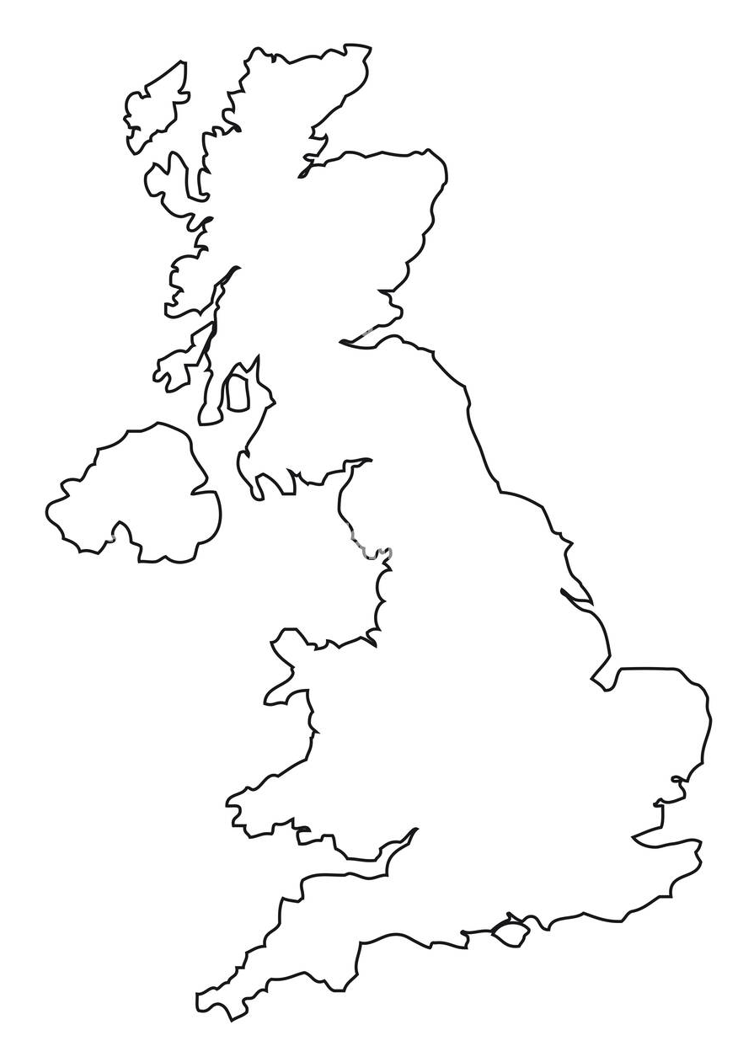
THE PROBLEM :
Our Cafe owner(Super Cafe) want to be able to:
monitor sales at multiple stores
check stock levels in real-time
check and reward valuable customers

Slide 4
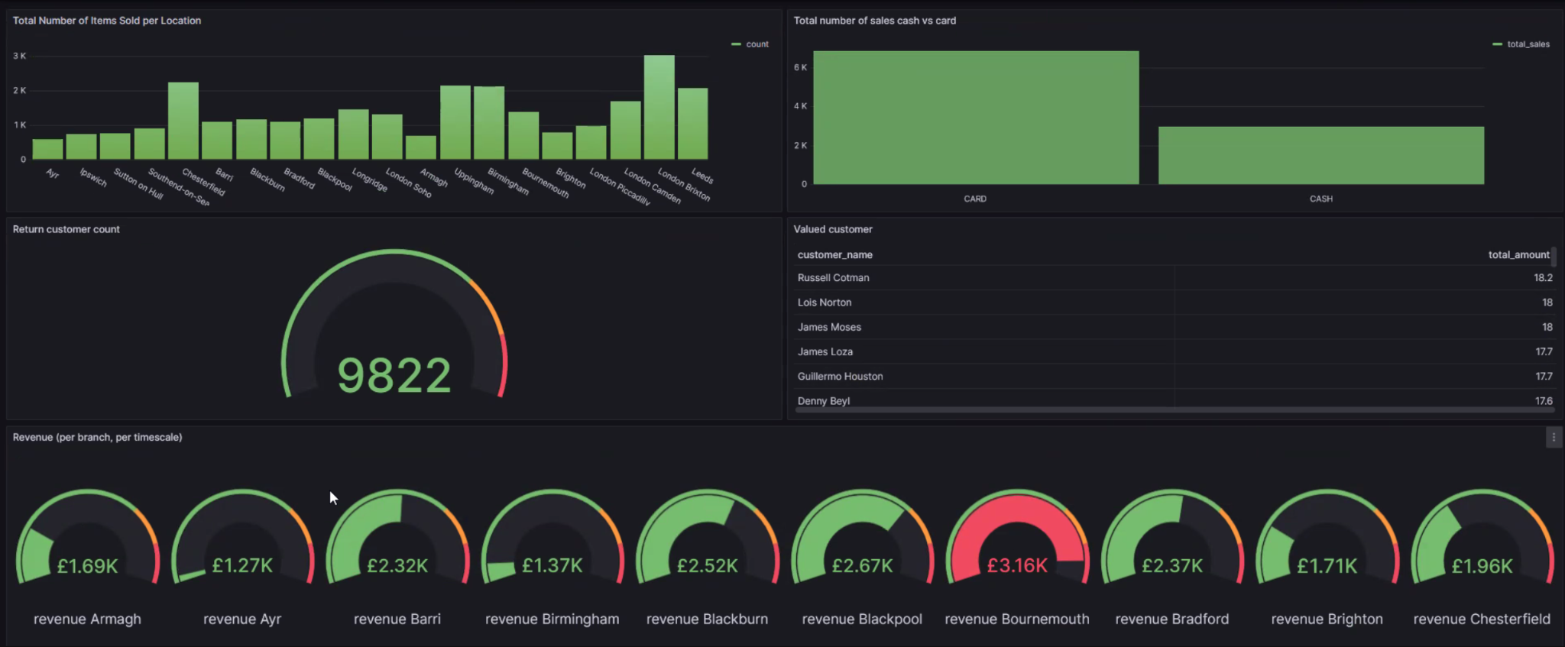
THE SOLUTION :
A backend system that visually displays sales data IN REAL TIME

Slide 5
WHAT IS ETL ?
So what is an ETL pipeline?

Slide 6
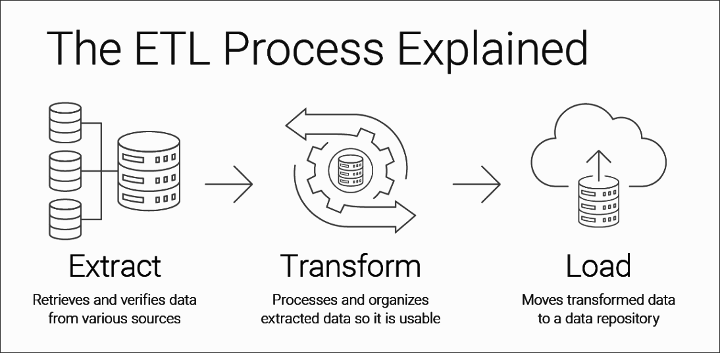
The ETL process involves the extracting, transforming & loading of data

Slide 7



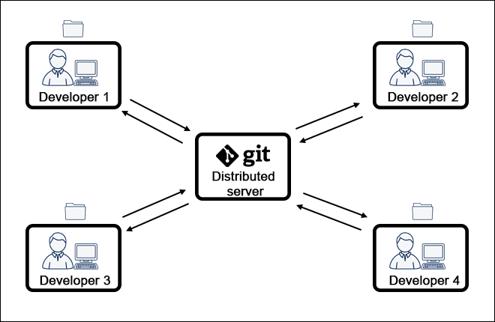
WHY LOCAL PRODUCTION ?
Cost
Security
Speed of delivery
Version control

Slide 8
AGILE:
How did Agile help us during our project?
Flexibility/ Adaptability
Development
Communication
Early Value Delivery.
Risk Management

Slide 9

Working functions
Catch bugs early
Insights for new developers
U N I T -T E S T I N G

Slide 10
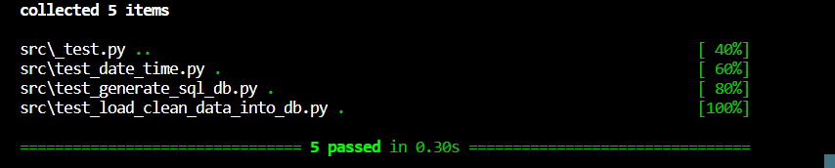






Tests Passed

Slide 11
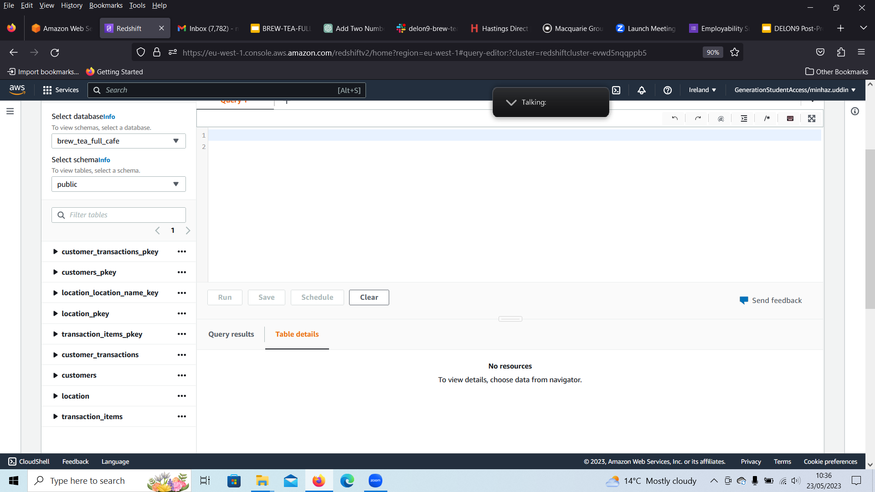
Configuring the Schema:
How did the Agile methodology effect how we approached our database?
What counts as sensitive data?
What is needed in our schema?
What is needed for a minimal viable product?
What did we try and didn’t work?

Slide 12
Pair programming and GIT
What are some things we can consider to most effectively meet our goals

Slide 13
WHAT IS EC2 ?
Is a web service provided by Amazon Web Services (AWS) that offers resizable compute capacity in the cloud

Slide 14
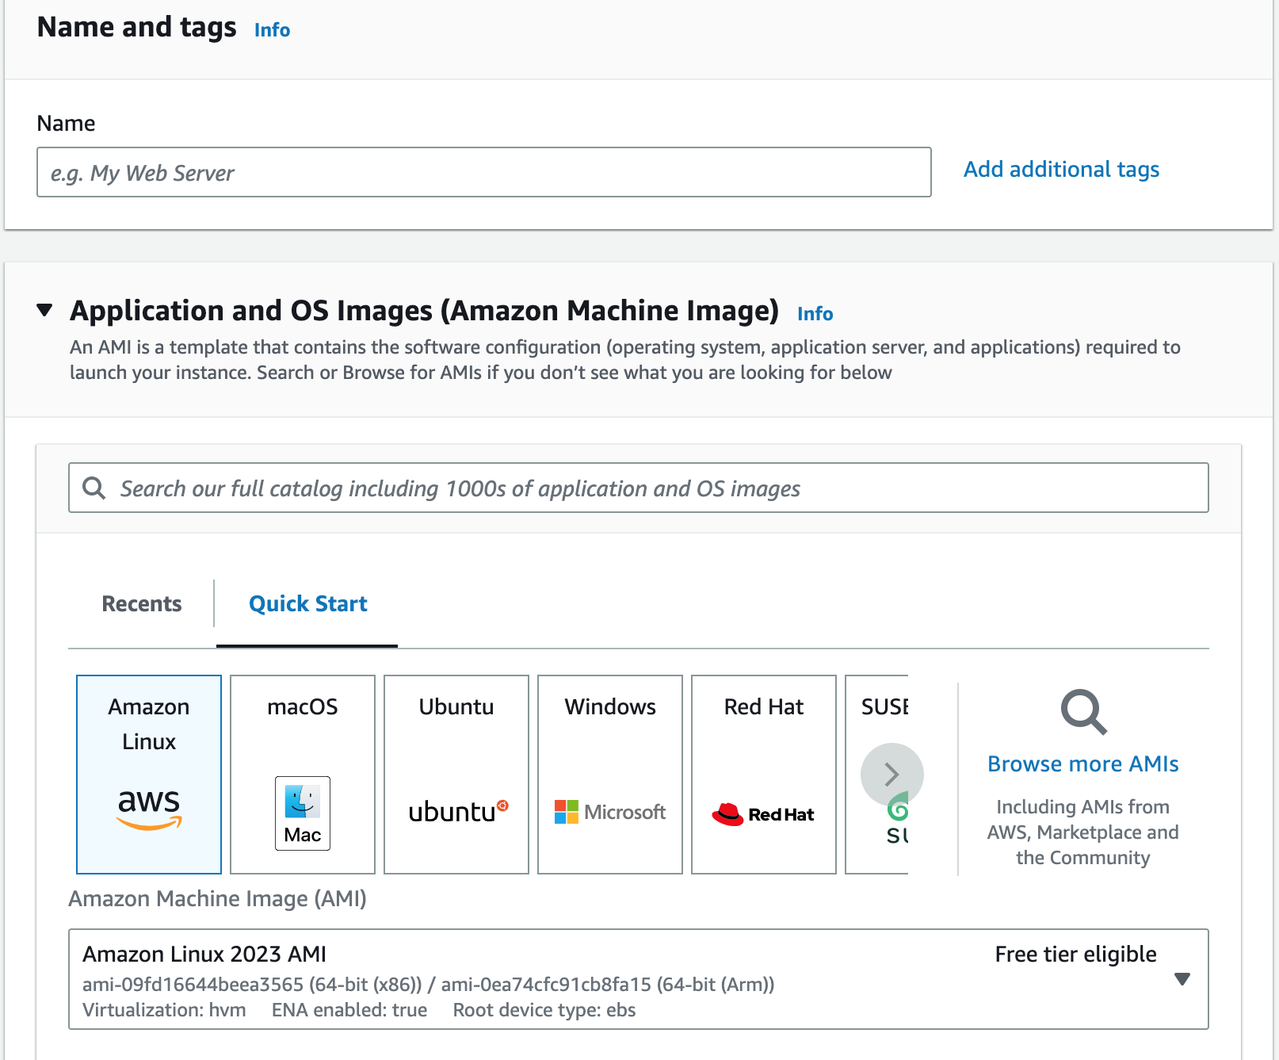
This is how we set it up.
The benefits:
-multiple OS to choose from
-secure
-adjust to rapid changes
-more secure
-faster development
-eliminates upfront investment

Slide 15
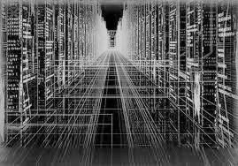

What is a lambda?
Compute service from AWS
Serverless architecture
Event driven system

Slide 16

Why use lambda?
100% code, 0% infrastructure
Scales automatically
Pay for use
Monitoring performance
Supports many languages

Slide 17
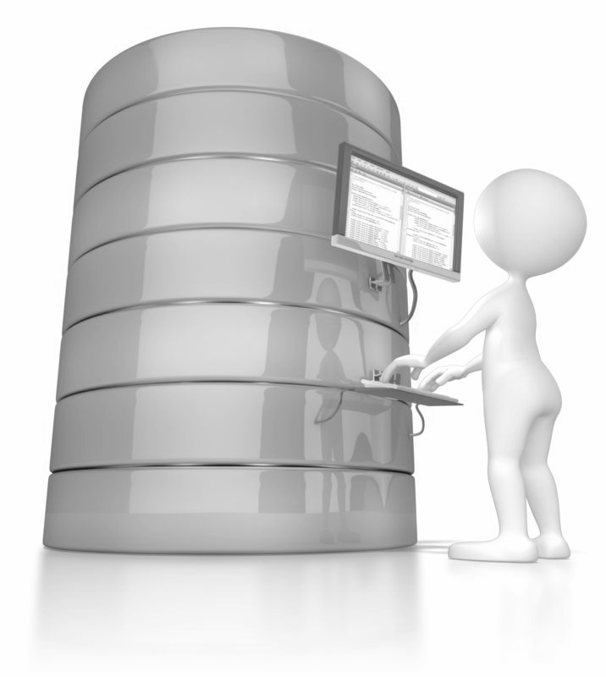
Why use Redshift database?
Tables in the cloud
Scalability
Compatibility

Slide 18
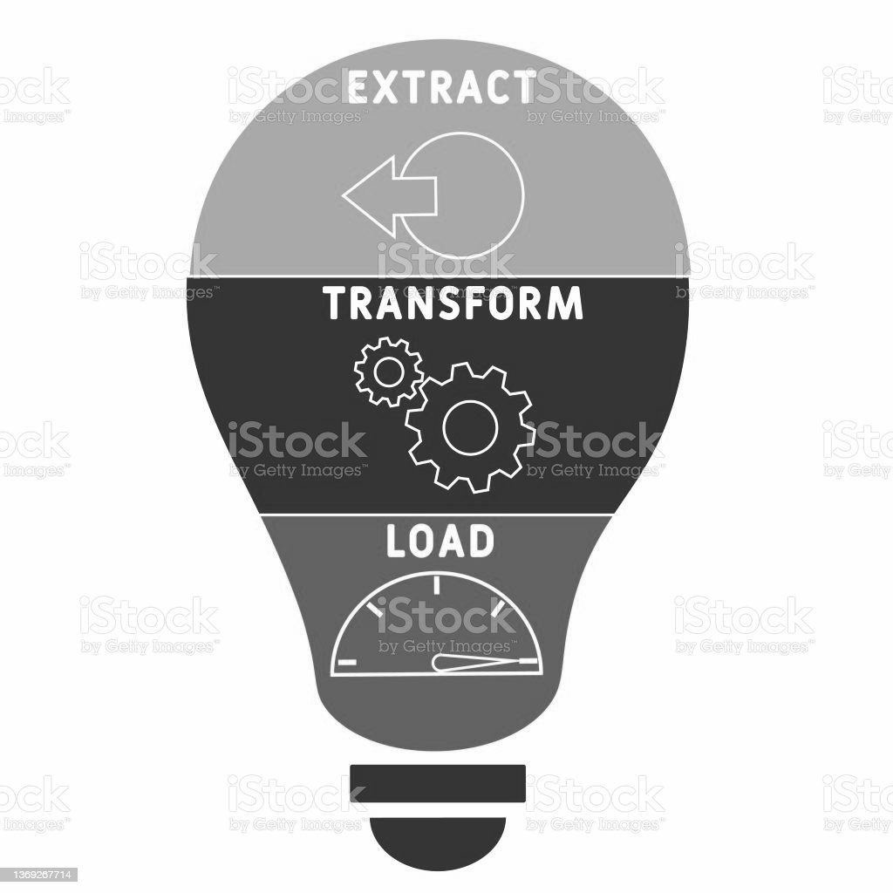
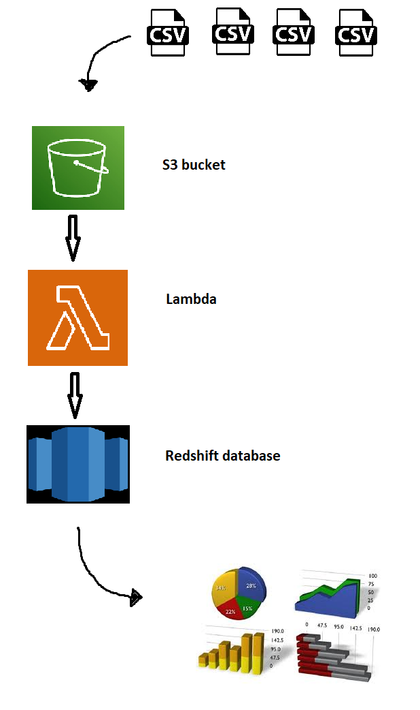

Our Lambda
Extract function
Transform function
Load function

Slide 19
Tables created in Redshift database

Slide 20
C L O U D F O R M A T I O N
Is an Amazon Web Service that enables users to model and manage infrastructure resources in an automated and secure manner

Slide 21
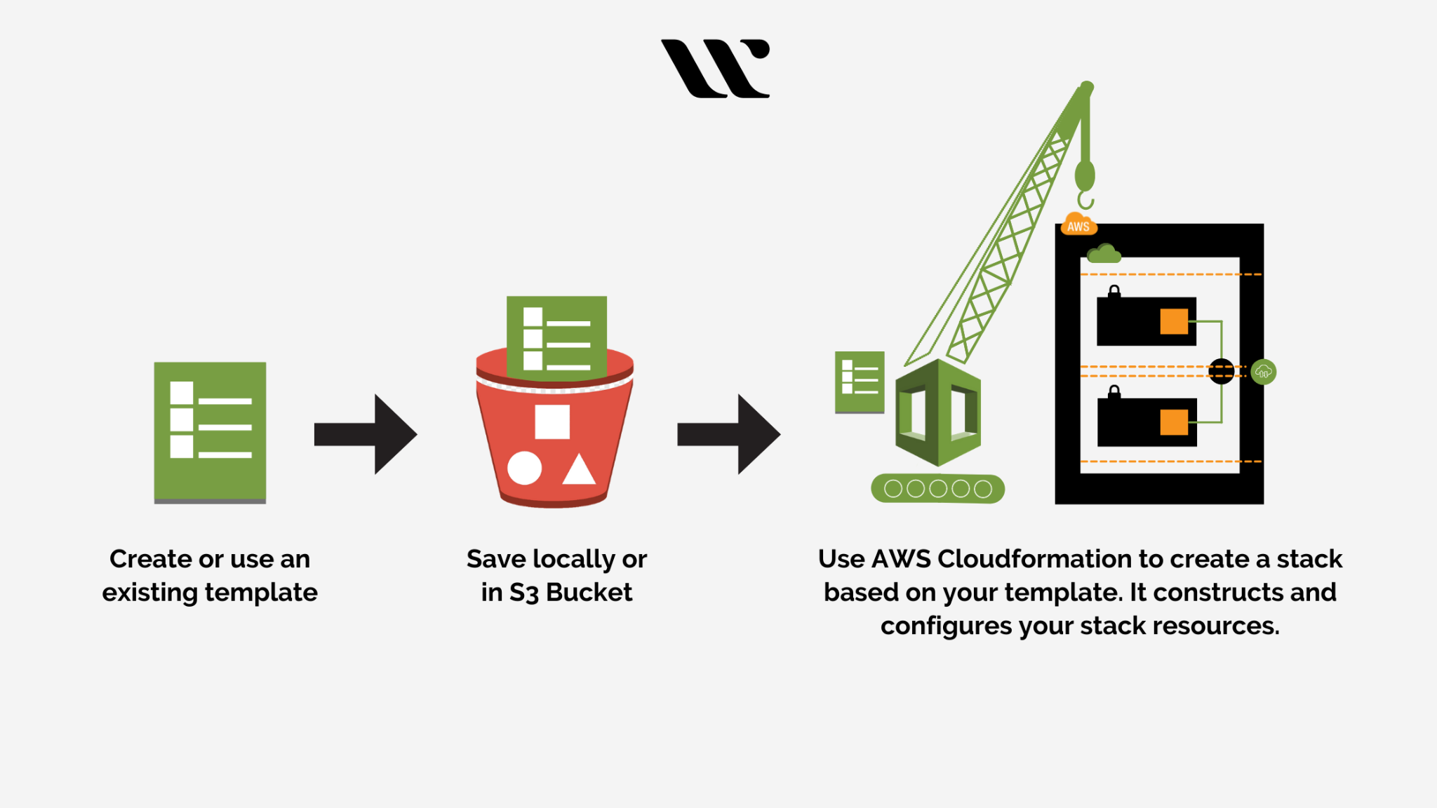
CLOUDFORMATION TEMPLATE
Describe your desired cloud environment, including AWS resources like EC2 instances, RDS databases, S3 buckets, IAM roles, security groups, and more
These templates act as blueprints for your infrastructure, allowing you to version control, reuse, and replicate your infrastructure deployments.

Slide 22



DATA SECURITY
IAM
Virtual Private Cloud
Systems Manager

Slide 23
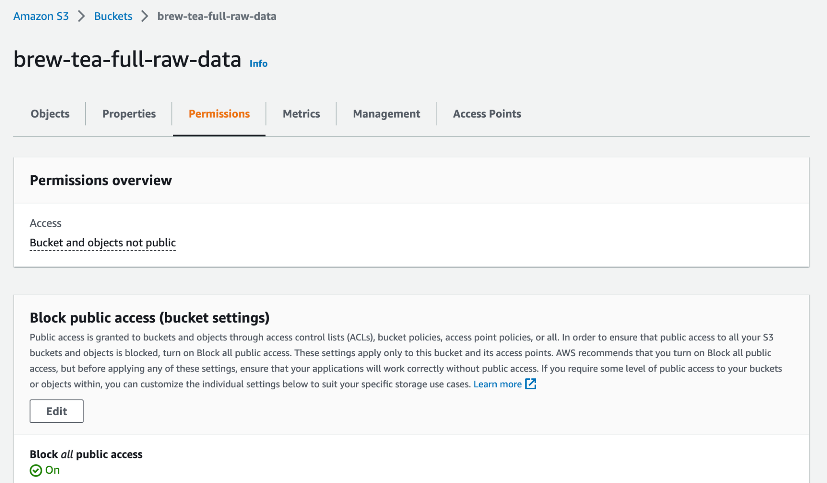
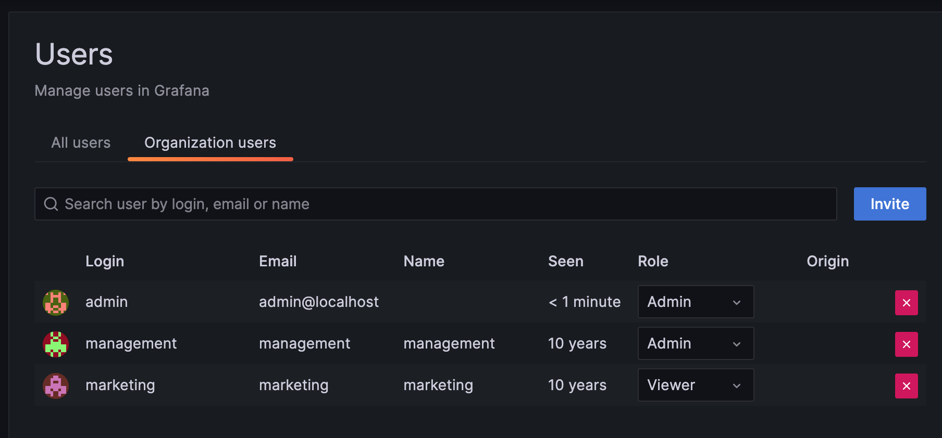
DATA SECURITY
Configuration
S3 Bucket privacy
Grafana user configurations

Slide 24

DATA SECURITY
Configuration
Accessing Redshift Database connection details from Systems Manager

Slide 25

DATA STORAGE:
Utilisation of the Amazon Web Service; S3 to collate and store raw data.
S3 Bucket

Slide 26

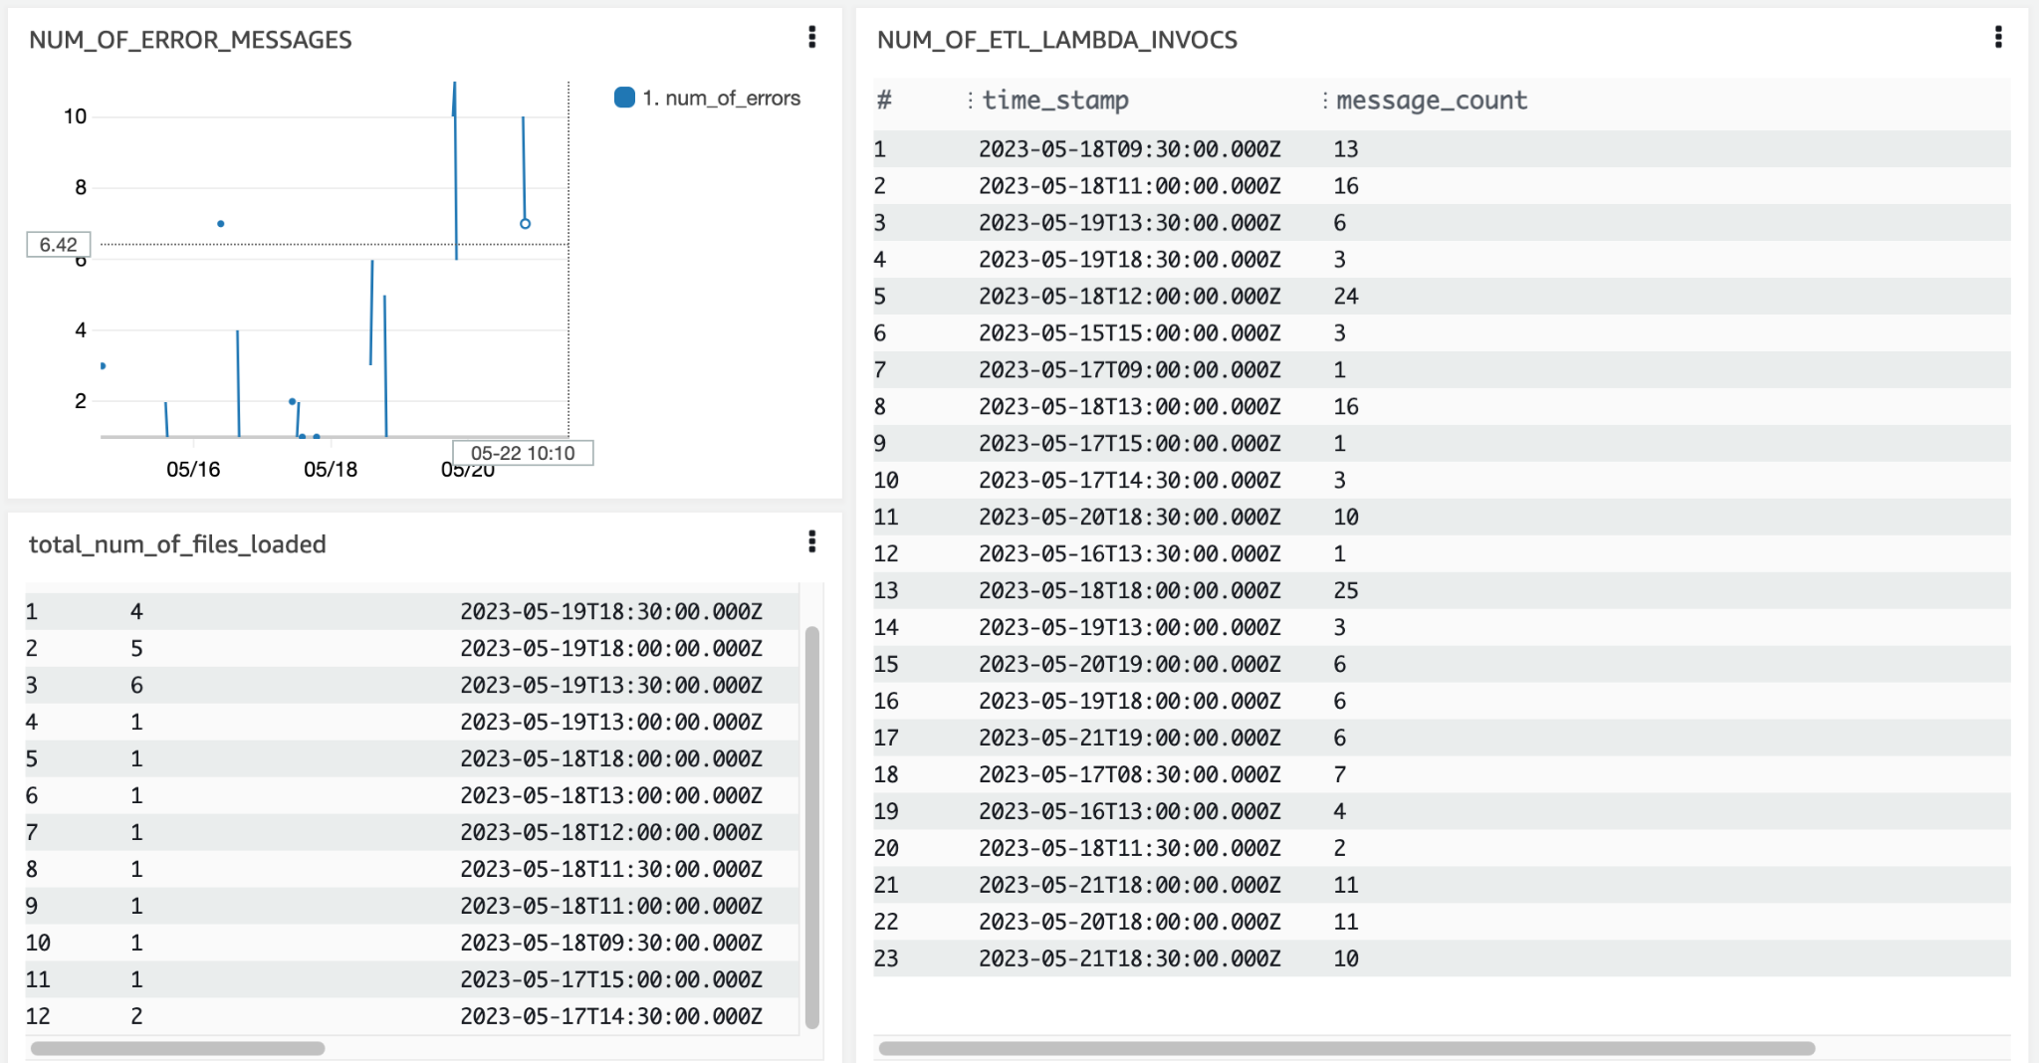
MONITORING:
Dashboards; getting a quick glimpse of crucial ETL performance data.

Slide 27
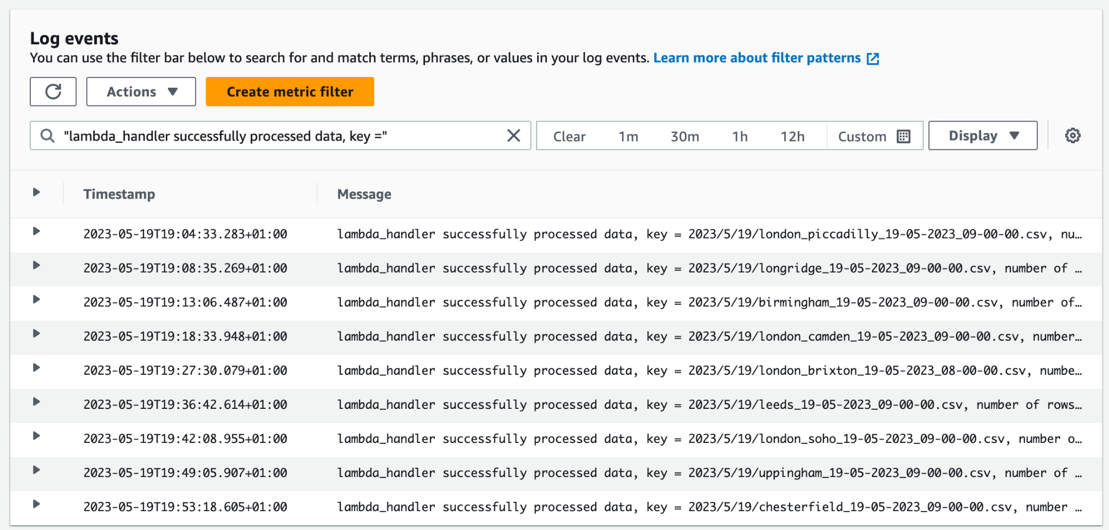
MONITORING:
Logging: Cutting to the chase.

Slide 28

Visualising the data with Grafana
WHY?
-storytelling
-accessibility
-show relationships
GRAFANA

Slide 29
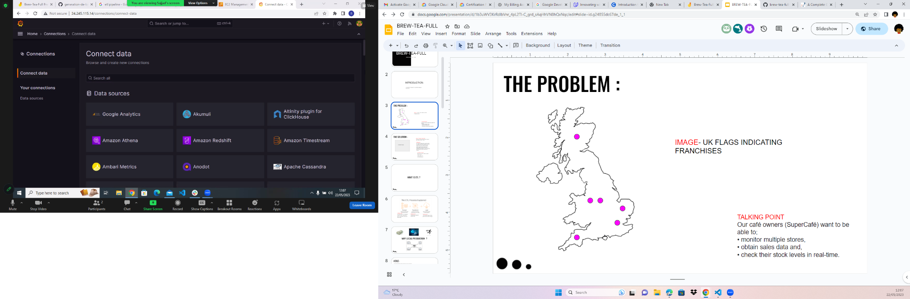
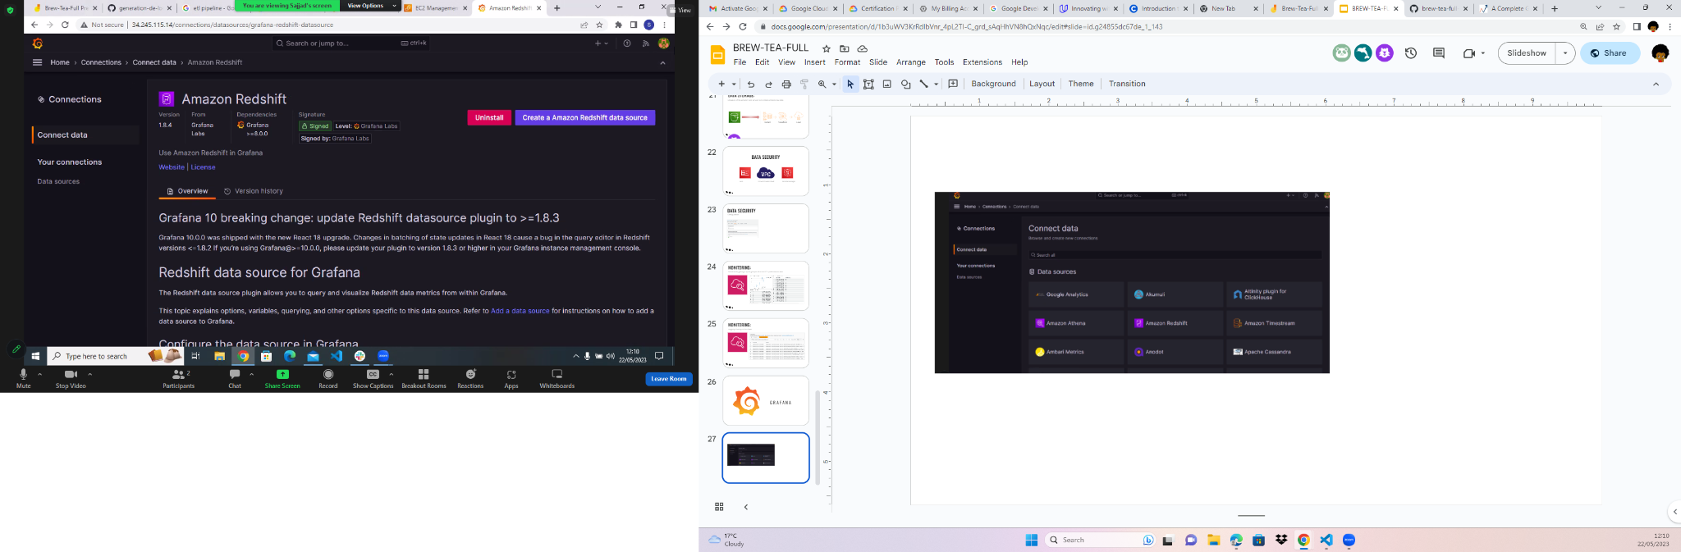
Grafana is a free and open source piece of software
D A T A S O U R C E S

Slide 30
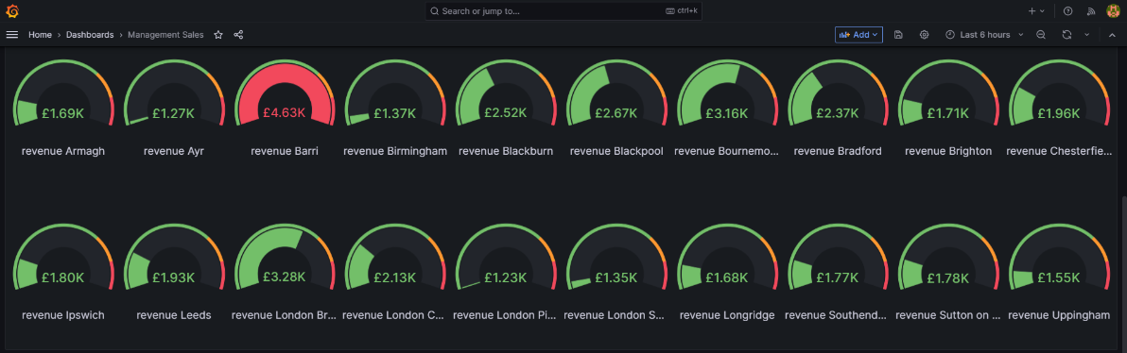
data visualization allows you to see a high-level view of your data

Slide 31
Thank you for staying awake
Our thoughts?

